Slide 1
Lecture Title: Recursion (Cont.)
Course Code: CSC 2211
Course Title: Algorithms
Dept. of Computer Science
Faculty of Science and Technology
Lecture No: | 04 | Week No: | 04 | Semester: | Spring 20-21
Lecturer: | Name: Mushfiqur Rahman; E-mail: mushfiqur@aiub.edu

Slide 2
Lecture Outline
Divide and Conquer (Previous Week)
Recurrences in Divide and Conquer and methodologies for recurrence Solutions (Previous Week)
Repeated Backward Substitution Method (Previous Week)
Recursion Tree
Master Method

Slide 3
Recursion Tree
A recursion tree is a convenient way to visualize what happens when a recurrence is iterated.
  Good for ”guessing” asymtotic solutions to recurrences
Step 1: Drawing a recursion tree based on the recurrence relation.
Step 2: Finding the following info for the recursion tree:
  Cost of each level
  Total number of levels in the tree
  Number of nodes in the last level
  Cost of last level
Step 3: Adding cost of all levels of the recursion tree and simplifying the expression to find out the asymptotic relation.

Slide 4
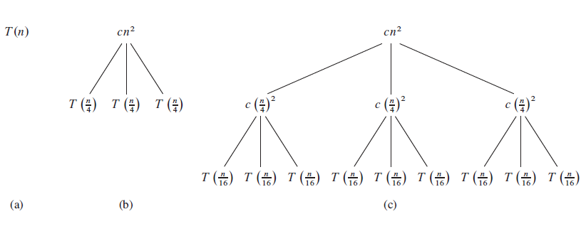

Slide 5
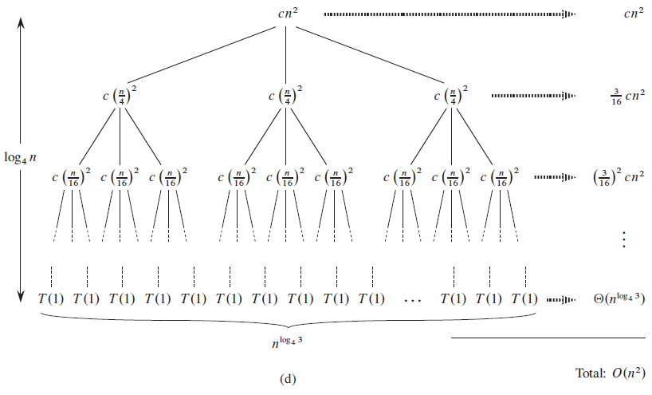

Slide 6
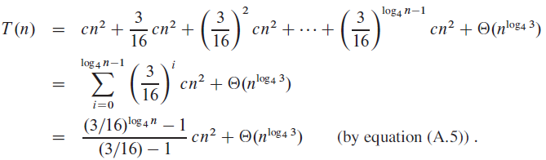
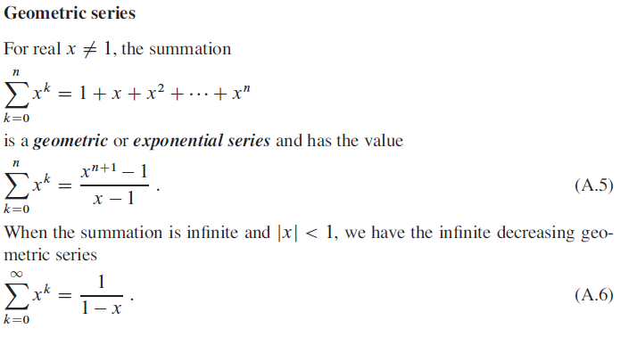

Slide 7
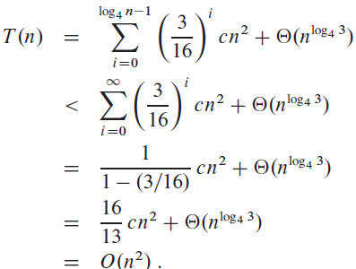

Slide 8
References & Readings
CLRS
  Chapter: 4 (4.1-4.3)
  4.4 for bedtime reading
  Exercises
    4.1, 4.2, 4.3
  Problems
    4-1, 4-4
HSR
  Chapter: 3 (3.1-3.6)
  Examples: 3.1-3.5
  Exercises: 3.1 (1, 2), 3.2 (1, 3-6),

